Slide 1
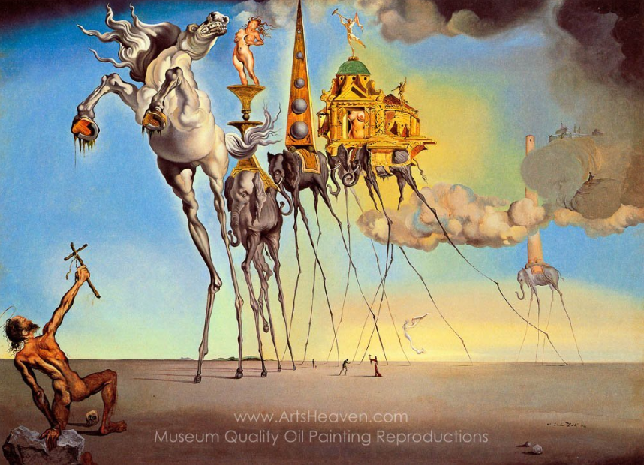
SURREALISM
&
Sigmund Freud's
Psychoanalytic Methods
History of Modern Art
BFA-III (Visual Arts)
Course Incharge: Ms. Sidra Liaqat
Institute of Design & Visual Arts, LCWU

Slide 2
Max Ernst
(1891–1976)
German-French-American

Slide 3
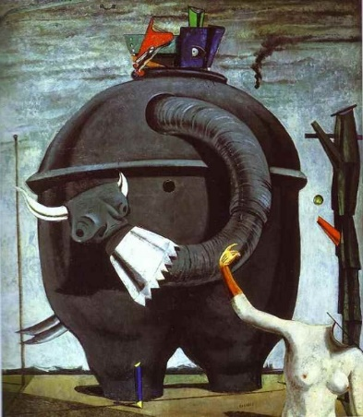
MAX ERNST
“The Elephant Celebes”
Oil Paint
(1921)

Slide 4
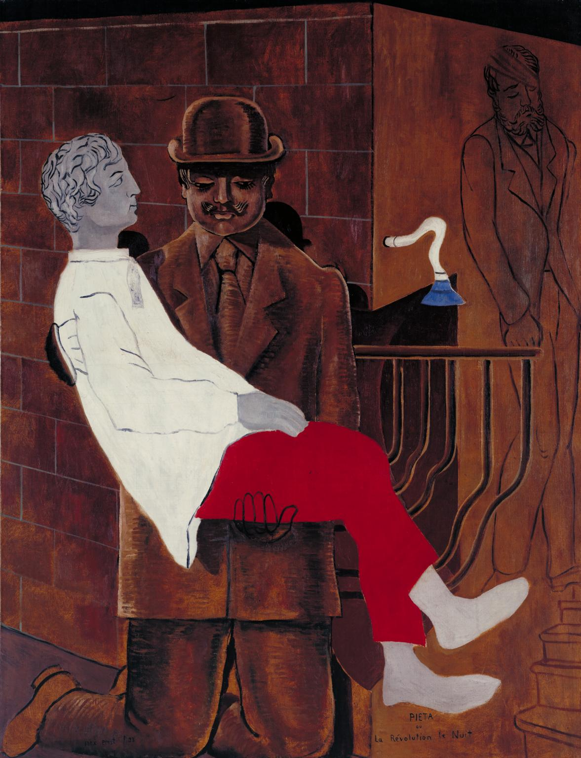
MAX ERNST
“Pietà” / “Revolution by Night”
Oil Paint
(1923)

Slide 5
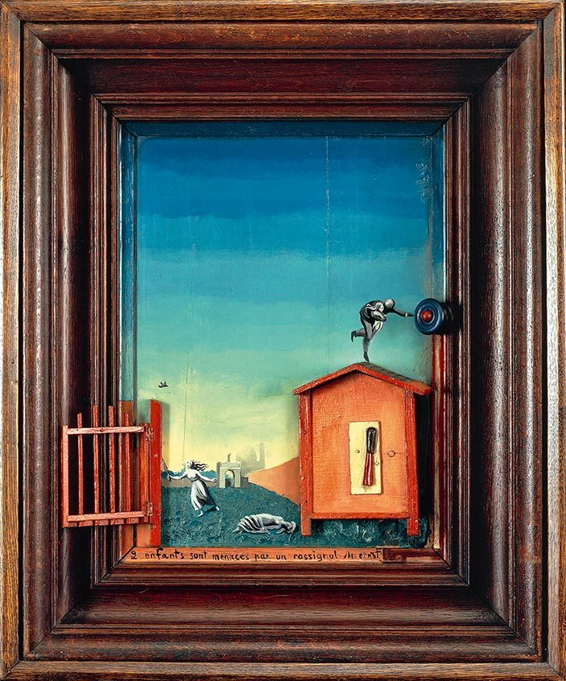
MAX ERNST
“Two Children are Threatened by a Nightingale”
Oil on Wood with Wooden Construction (1924)

Slide 6
Salvador Dalí
(1904-1989)
Spanish

Slide 7
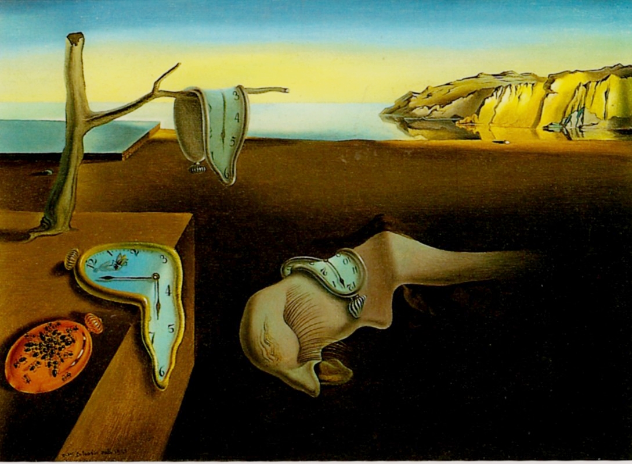
SALVADOR DALÍ
“The Persistence of Memory”
Oil on Canvas
(1931)

Slide 8
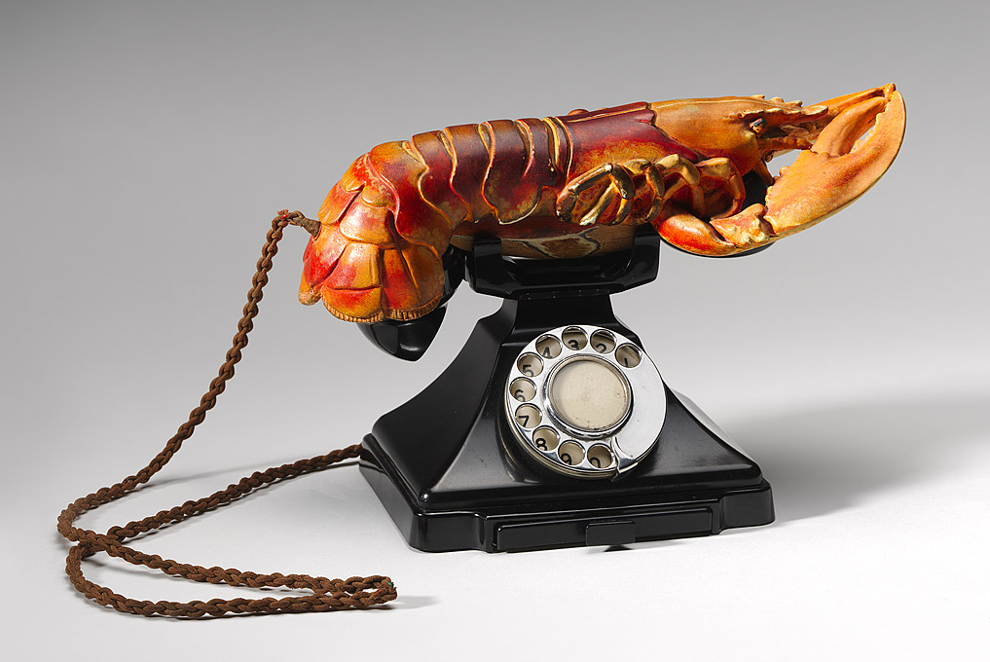
SALVADOR DALÍ
“Lobster Telephone”
(1936)

Slide 9
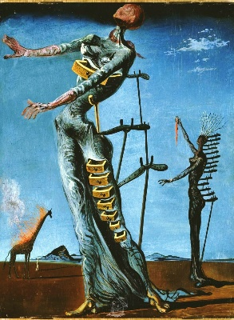
SALVADOR DALÍ
“Burning Giraffe”
Oil on Wood Panel (1937)

Slide 10
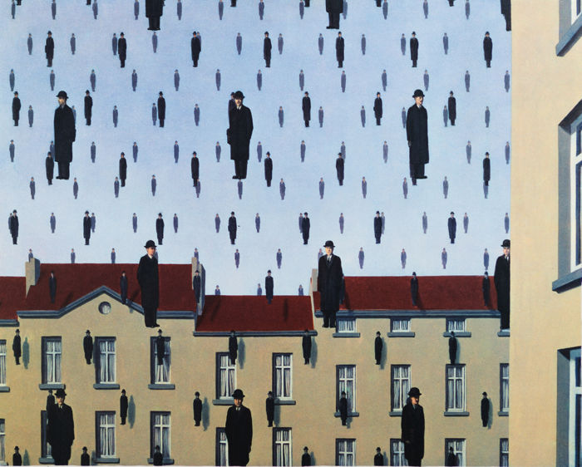
René Magritte
(1898–1967)
Belgian
RENÉ MAGRITTE
“Golconda”
Oil Paint (1953)

Slide 11
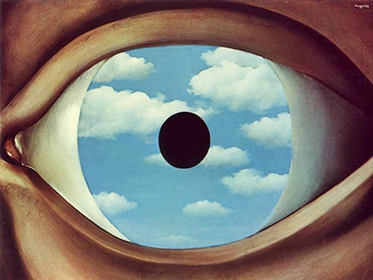
RENÉ MAGRITTE
“The False Mirror”
Oil Paint
(1928)

Slide 12
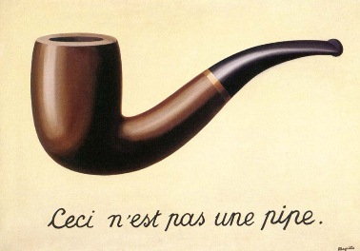
RENÉ MAGRITTE
“The Treachery of Images”
Oil on Canvas
(1929)

Slide 13
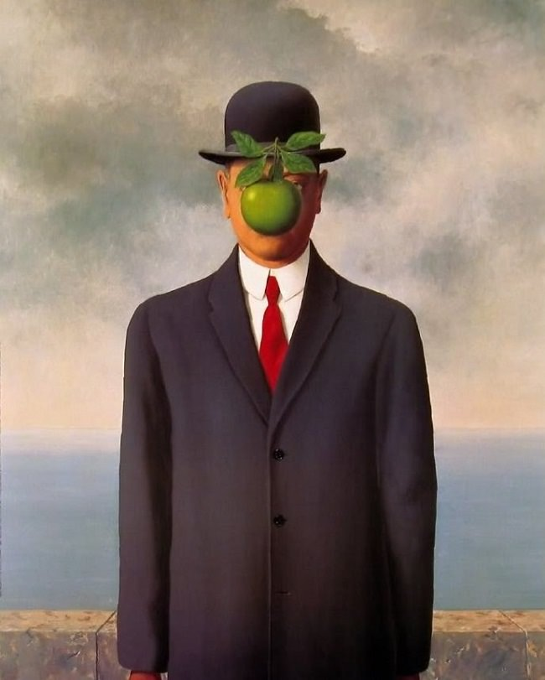
RENÉ MAGRITTE
“The Son of Man”
Oil Paint
(1946)

Slide 14
Méret Oppenheim
(1913-1985)
Swiss

Slide 15
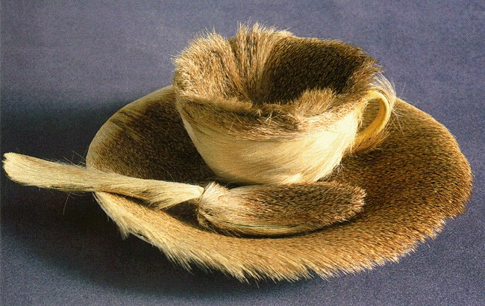
MÉRET OPPENHEIM
“Object”
Fur-covered Cup
(1936)

Slide 16
Joan Miró
(1893-1983)
Spanish

Slide 17
JOAN MIRÓ
“Painting”
Oil on Canvas
(1933)

Slide 18
JOAN MIRÓ
“Summer”
Oil on Canvas
(1938)

Slide 19
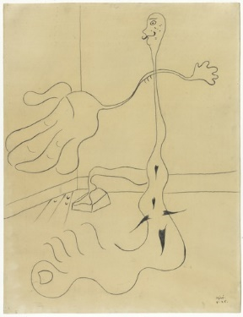
JOAN MIRÓ
“The Statue”
(1926)

